Slide 1
welcome to My Presentation Name: Saiful islam shihab student id: 171-35-1970

Slide 2
C programming project on Vehicles reservation system

Slide 3
‘Vehicles Reservation System’ is a online based system that provides the transportation facility to the customer based on their requirements. This system provides different types of Cars (Luxury, SUV) or Buses for better travelling.

Slide 4
1. Admin portal 2. User portal

Slide 5
Adding project information
Available routes
Driver information
Vehicles information
Rent
back

Slide 6
Display project information
registration
2. inquiry
3. reservation
back

Slide 7
Available routes
2. Driver information
3. Vehicles information
4. Rent (car hire charge & bus ticket price)
back

Slide 8
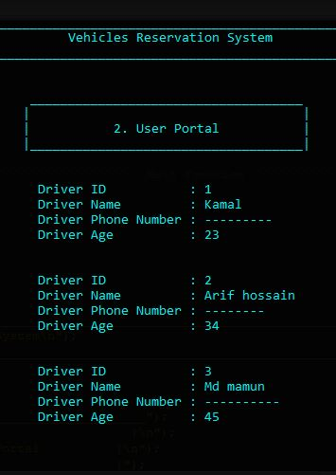
back

Slide 9
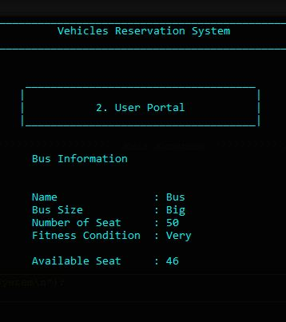
back

Slide 10
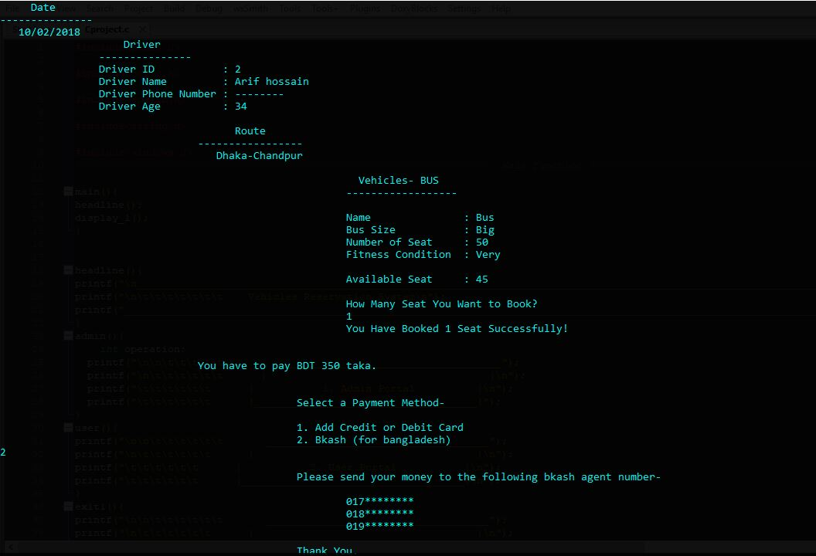
back

Slide 11
Thank you

